Slide 1

Deepening the Toolbox:
Advanced Strategies for Trust Repair
Department of Retirement Systems
Retirement Services
Dr. Wendy Fraser, Fraser Consulting, LLC

Slide 2
Introductions
At your Table
  Introduce yourself: name, position
  Briefly describe one tradition that is meaningful to you (holiday, event, family, food, etc.)

Slide 3
Outline of our time together today…
Learn a diagnostic model of assessing trust and relationship issues that affect teams and organizations.
Explore the trust repair model and suggested tools within each phase to strengthen relationships.
Apply these strategies to your own personal/professional group situation.
Notes:
.

Slide 4
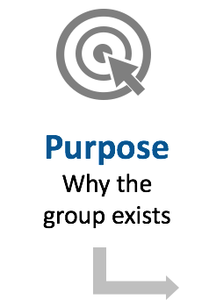
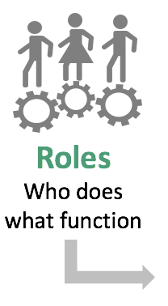
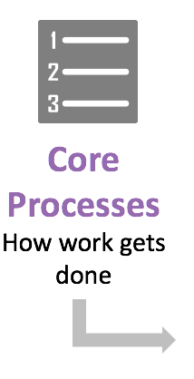
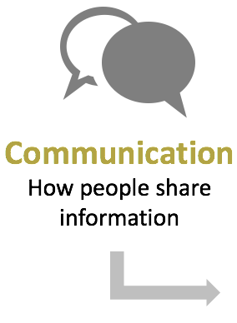
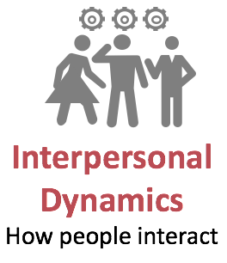
Trust Behaviors
Behaviors that affect relationships in groups
© Wendy Fraser, PhD, 2017

Slide 5

Most Common Trust Violations
89%
Purpose Why the group exists
Roles
Who does what function
Core Processes How work gets done
Communication How people share information
Interpersonal Dynamics
How people interact
18%
36%
61%
75%
Categories of trust problem areas
© Wendy Fraser, PhD, 2017

Slide 6
Model of Inquiry
Purpose
Roles & Responsibilities
Core Processes
Communication
Interpersonal Dynamics
Structure: organization scope, design, alignment, and operations
Dr. Wendy Fraser, 2002

Slide 7

Personal Application – In pairs (10 min)
Think about a group who is not functioning well.
Use the Trust Behaviors handout as a diagnostic model and explore what you think are the root issues for the group not functioning well.
List out the category (purpose, role, core process, communication, and interpersonal dynamics) and possible behaviors.

Slide 8
© Dr. Wendy Fraser, 2016

Slide 9
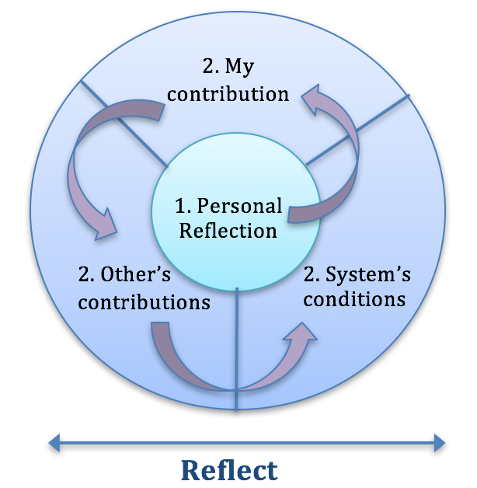
Reflect Stage Purpose
Get clear about
  What did I do to contribute?
  What did others contribute?
  What is happening in the group or organization that is affecting us?

Slide 10
Reflect Tools
  Reflection Questions
  Systems/Relationship Mapping
  Choice Matrix
  Belief Systems
  Trust Assessment
  Force-Field Analysis

Slide 11
Personal Application – in pairs (20 min)
Use one of the tools to help explore what may be contributing to the situation.
Discuss with your partner

Slide 12
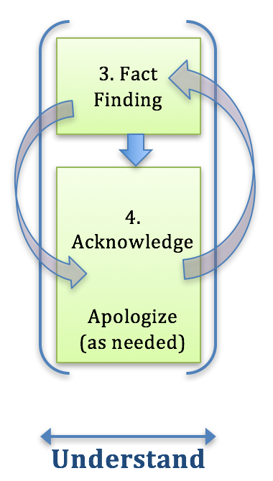

Understand Phase Purpose
Acknowledge your part and apologize as needed.
Work on getting clear about what happened.
Give each person a chance to share their perspective.

Slide 13
Understand Tools
  Ladder of Inference
  Mediation
  Art of the Apology
  Wrong v. Right Mindset
  Better Conversations

Slide 14
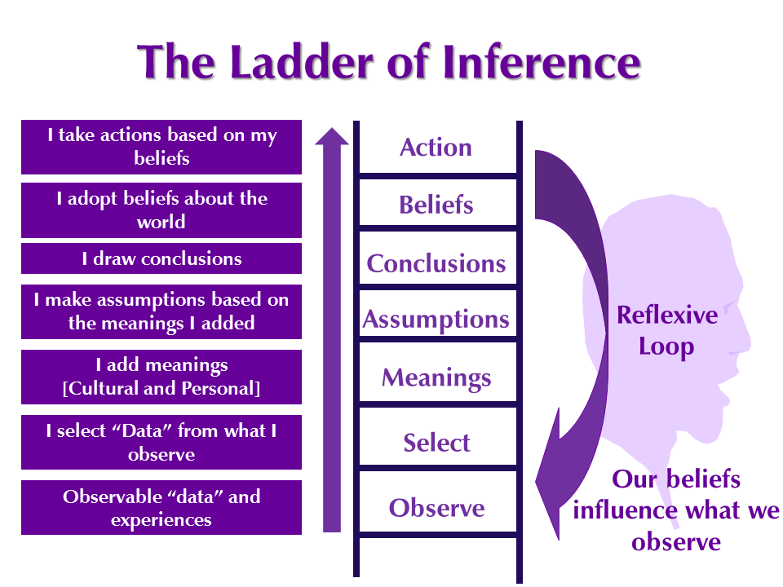

Slide 15
Personal Application – in pairs (20 min)
Use the Ladder of Inference to help explore what may be contributing to the situation.
What do you think the team members need to know?
How will you use this tool to support their learning?
Discuss with your partner

Slide 16
Repair Phase Purpose
Repairing trust takes courage
And a mindset that human beings can evolve and change…
The question becomes:
Who do I want to be today?
Be intentional... Make new agreements.
How does it serve me to hold onto the past? What do I need to move forward?

Slide 17
Repair Tools
Johari Window
Values Model
Art of the Apology
Feedback
Charters
Team Ground Rules

Slide 18
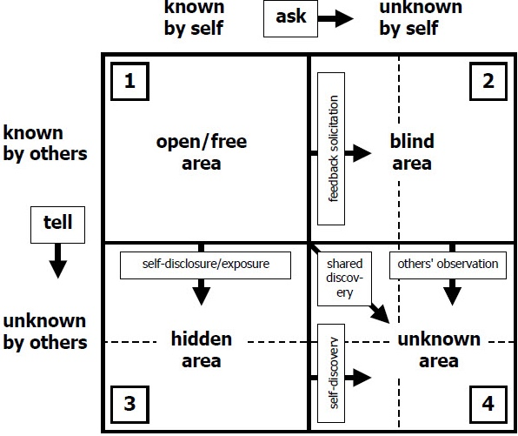
Johari Window
Joseph Luft & Harrington Ingham (1955)
Notes:
Self-disclosure and self-awareness are important leadership traits.
Model developed by American psychologists Joseph Luft and Harringon Ingham studying group dynamics at UCLA.
Four Regions
1. open area or open self - what is known by the person about him/herself and is also known by others
2. blind area or 'blindspot' - what is unknown by the person about him/herself but which others know
3. hidden area or hidden self -what the person knows about him/herself that others do not know -,
4. unknown area or unknown self - what is unknown by the person about him/herself and is also unknown by others
Aim for groups is to expand the open area to
Promote trust
Prevent miscommunication and confusion
Increase understanding, reduce conflict

Slide 19
Values Model
Values | Behaviors/Actions | Results
 | “Brutally honest” “Tell it like it is” without any filter

Slide 20
Values Model
Values | Behaviors/Actions | Results
 | “Brutally honest” “Tell it like it is” without any filter | Hurt feelings Shock Don’t want to work with that person anymore

Slide 21
Values Model
Values | Behaviors/Actions | Results
Honesty | “Brutally honest” “Tell it like it is” without any filter | Hurt feelings Shock Don’t want to work with that person anymore

Slide 22
Personal Application – in pairs (20 min)
Use the Values Model to explore your group situation.
What re-frame is needed to work better?
Discuss with your partner

Slide 23
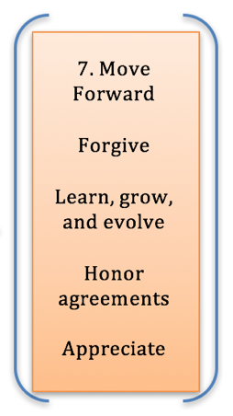
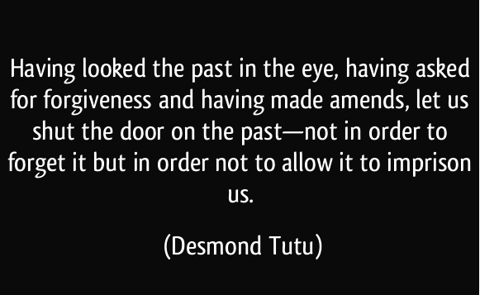
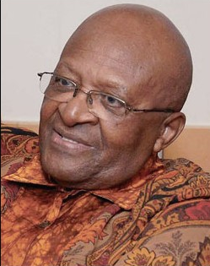
Evolve Phase Purpose

Slide 24
Evolve Tools
Tools
Check-in, Check-out
Support Model
Forgiveness
Huddles
Re-contracting
Fun Activities

Slide 25
Before… Trust Issues Surface
Create a set of agreements (structure):
Use charters
Set clear roles and responsibilities
Create support systems
Acknowledge past and present realities
Say where you have messed up in the past, how you learned, and what you intend to do differently now

Slide 26

Before…Trust Issues Surface
Be authentic and transparent about intentions, hopes, and issues that may concern you.
Be open to changing your mind
Have faith and confidence in people and their work
Communicate often to your team
Acknowledge and appreciate their work
Be clear about your expectations

Slide 27
During…the situation when trust is eroding
Refer to the structural agreements
Does anything need amending?
Acknowledge trust issues are emerging
Explore the root causes
Talk it through
Be willing to alter approach
Own your part in the situation
Take the time, have patience, a little bit of humor can go a long way

Slide 28

After Trust is Violated…Working to Repair
Refer to the trust repair model in this presentation
Acknowledge your part and apologize as necessary

Slide 29

After…Working to Repair Trust
Be intentional about repairing trust and the issues
Strengthen and modify structural items
Reaffirm and communicate intentions to work through this as long as it takes

Slide 30

Check-Out
What is the most important thing you learned today?
Contact Information:
Dr. Wendy Fraser
WendyFraser@comcast.net
360-556-6056
www.WendyF.com
“Trust Repair” book – ready in early 2018.

