Slide 1
Continuous Performance Improvement at Seattle Children’s Hospital
Lessons in Leadership: Getting Leaner – Getting Results
March 24, 2011

Slide 2
Our CPI Philosophy
Focus on the Patient and Family
  Involve patients and families in our improvement work
  Don’t imagine we know what they want, listen
  The uniqueness of our patients should be our only variation
Support Faculty and Staff in their Work
  Give people the opportunity to participate
  We are partners to be engaged, not customers to be served
  Make it easy to do the right thing
  No Layoffs
Take a Long Term View
  Relentless, iterative improvement (PDCA)
  Patience, this is generational work
  Focus, avoid the squirrel syndrome
Notes:
2
Children’s work is grounded in our CPI philosophy.
Our goals support that philosophy.
All of our goals, directly or indirectly, focus on the patient and family and support our people in their work, primarily by removing waste from our systems and processes.
Many of our goals are multi-year because we take a long term view – we know we can’t improve everything overnight – so we take an iterative incremental approach over time.

Slide 3
Our Approach
Leader Guidance and Direction: this is our management system, our method of improvement
Staff (and Family) Participation: this is how we will improve
Understand the Sequence of Work: map the process
Identify Waste: reduce or eliminate it
Notes:
3

Slide 4
A Few Words About Waste…
Waste comes cleverly
disguised as real work

Slide 5




Waste Comes in Many Forms
Processing
Correction
Search Time
Transportation
Underutilized People
Wait Time
Space
Inventory
Complexity
Notes:
Slide Purpose: To introduce the 9 types of waste, describe each and provide healthcare examples of each
Suggested talking points:
Waste is often cleverly disguised as “real work” so it is important to develop your waste identification skills.
There are 9 types of waste. They are described below along with healthcare examples
Processing -Redundant and unnecessary process steps, excess processing. Excess use of energy of all type. Healthcare Examples: Hard copies of procedure manuals when available online. Redundant capture of information from families, intellectual set-up or reset time when switching between tasks
Correction - Re-do’s, fix-ups, returns, mark-downs, managing customer complaints. Healthcare Examples: Fixing errors made upstream; service recovery activities, correcting mistakes caused by incorrect information or miscommunication. Illegible orders or documentation, incorrect abbreviations requiring follow-up
Inventory -Idle in progress or finished materials, ingredients, supplies, or information. Healthcare Examples: Patients in exam rooms waiting for the MD, (this is closely linked to the waste of wait time) Excess inventory of medical supplies, patient referrals waiting to be scheduled
Wait Time - Delays and queues of all types. Healthcare Examples: Patients waiting anywhere. Early morning admissions for surgeries that won’t be performed until later that day, waiting for support services such as transport or linen.
Search Time - Time spent looking for information, people, supplies and equipment. Healthcare Examples: Staff searching for supplies or equipment, physicians searching for test results, RN’s searching for the right supply to perform a procedure, FSR’s searching for paperwork
Transportation -Multiple handling steps and needless movement of material and information. Healthcare Examples: Supplies that move in and out of multiple storage areas before use, staff moving in and out of an OR during surgery for supplies and equipment. The goal is to continuously minimize the movement of all things while looking for ways to put materials, supplies and equipment where needed when needed.
Space - Storage of unneeded items, excess inventory or the general “mess” that builds up over time. Excess space required due to inefficient process flow. Healthcare Examples: A operating room used to store equipment, patient waiting rooms, space filled with excess inventory of supplies, multiple copies of source documentation on individual computers and electronic files.
Complexity -Complex process flows. Product choices that confuse customers. Organization boundaries which introduce inefficiencies and frustrate customers. Healthcare Examples: Forty different types of band-aids for patients to choose from, inefficient communication channels, entering info into 3 different computer systems to get information on your patient.
Underutilized People - Although many personnel are cross-trained and capable of doing many different jobs, some staff are assigned limited tasks, such as entering orders, or ordering materials. The more functions a person learns, the more valuable he/she is to the organization. Expanding a person's duties and responsibilities may also be a means of reducing other wastes, such as re-entering of information, redundant approvals. Healthcare Examples: Nursing “no-pays”, not involving all affected roles in standardizing work practices

Slide 6
A Few Words about Leadership
Presence
Knowledge
Participation
Tenacity
Patience
Notes:
Presence: Senior leadership must be visible
Knowledge: Senior leadership must be trained
Participation: Senior leadership must participate in CPI events
Tenacity: Senior leadership must make it clear that “resistance is futile”
Patience: Senior leadership must be prepared for failure, and persevere. Not every CPI event will succeed.

Slide 7
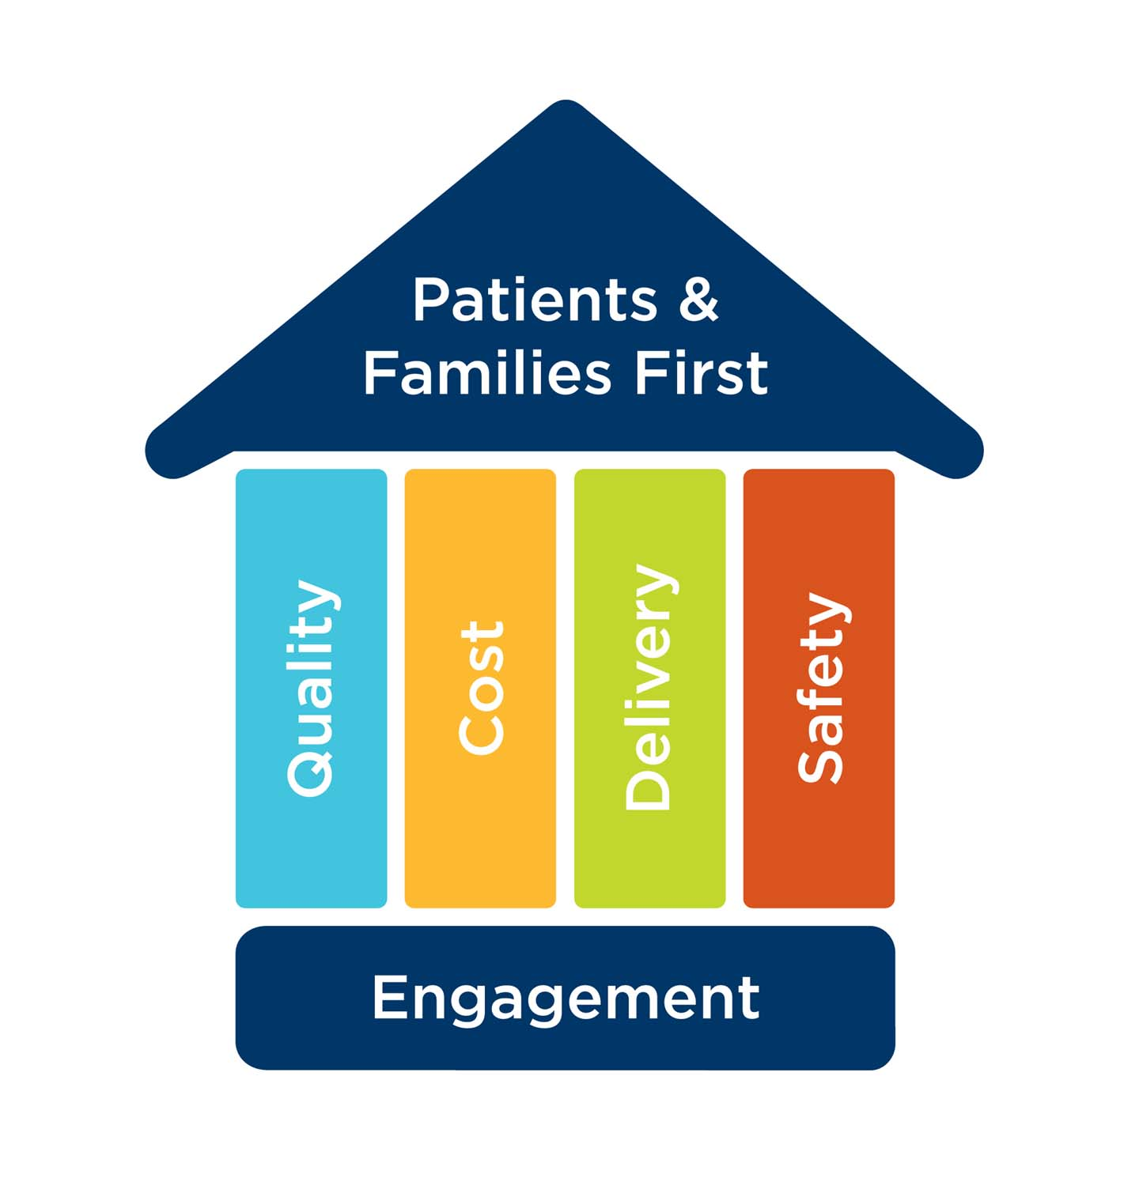
Continuous Performance Improvement: Our Results
Notes:
At Children’s, we have simplified the “CPI” house and made it our own.
Our CPI House focuses on Patients and Families as the apex of all we do – the roof of our house.
Supporting the roof are the pillars of Quality (of care and service), Cost, Delivery (or access), and Safety (for patients and staff). The pillars are inter-related, and together support the roof.
The Foundation for the entire structure is the Engagement of our Faculty and Staff. We will not succeed without them.

Slide 8
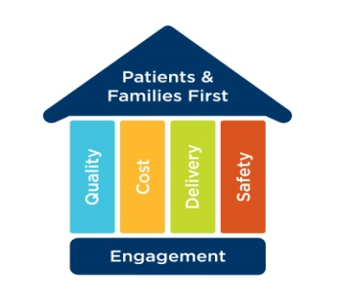
Quality – Overall Rating of Care
Lower is better!

Slide 9
Cost
New Ambulatory Clinic and Surgery Center
  Using CPI principles, reduced building size from the architect’s original program by approximately
  30,000 sq ft
    $20 million capital cost avoidance, plus
    $10 million construction cost savings

Slide 10

Delivery - Central Line Access
Year 1
Year 2
Year 3

Slide 11

Safety - Blood Stream Infections
Notes:
11
From Joan Heath
11

Slide 12

Gallup Q^{12®} Engagement Index at Children’s
Over Time
Ratio of Engaged to Actively Disengaged:
1.32:1 2.92:1 3.42:1 4.20:1 3.75:1 5.56:1 5.56:1 6.25:1 5.67:1 6.50:1
Copyright © 2005 The Gallup Organization, Princeton, NJ. All rights reserved.
Notes:
Steady progress through the years of CPI.

Slide 13
CPI Can Be Applied Anywhere
March 11, 2011 CPI Report-Outs:
Dietitian Documentation
Feeding Tube Management
Primary Care Clinic Flow
Cardiac Surgery Scheduling
Research Grant Invoicing

Slide 14
Lessons Learned
This is hard work
Takes time and effort to see results
Very engaging for staff, faculty and families
Requires substantial leadership and financial investment
Learn to fish

Slide 15
CPI at Seattle Children’s Hospital
Thank you

