Slide 1
The 10 Plays to Driving Performance and Impact Delivery Process Overview & Capabilities
Jeff Press
Practice Leader, Government Performance, Socrata
Michael Jacobson
Deputy Director, King County Office of Performance, Strategy & Budget
Washington State Government Lean Transformation Conference
October 18, 2016

Slide 2
Re-branding performance management
Notes:
Contextualizing open data

Slide 3
Play #1: Make specific commitments with a focus on goal setting and prioritization
Do we have clear goals that we are trying to achieve?
Are goals too limited in number or are there too many to remember?
Can we easily show how we are achieving our goals?
Are there senior leaders who help us prioritize and who enforce our priorities?
Source: U.S. Performance Improvement Council

Slide 4
What is an example of a logic model?
HOW
WHY
Goal: Double U.S. Exports in 2 years
Outcomes
Inputs
Amount of budget and number of FTEs
Activities
Conduct export promotion at trade shows
Consult with businesses at U.S. Export Assistance Centers
Outputs
# of businesses receiving additional information
# of businesses with an export strategy
Customer
% of exporters satisfied with the information they received
# of businesses assisted
Short-term
Increase the # of firms pursuing export opportunities
Attitudes
Inter-mediate
Increase the # of firms exporting to more than one country
Behavior
Long-term
Increased $ value of exports
Increase in export-related jobs
Condition
PROGRAM
RESULTS FROM PROGRAM
External Influences
Factors outside of your control (positive or negative) that may influence the outcome and impact of your program or project
Source: U.S. Department of Commerce
Notes:
SCRIPT:
Resources/Inputs: Staff/FTE, operating budget, specific skills, knowledge, equipment or partners, 5 FTE, $2 million
Activities: The things you do – deliver technical assistance, conduct evaluations or design a database.
Outputs: Products or services that are a direct result of your activities. Technical assistance, evaluation report or emissions inventory.
Customers: Individuals you are trying to influence – managers, agency headquarters, regional or State staff. Beneficiaries are individuals or groups who will gain from the program’s efforts in the long-term.
Outcomes:
Short-term: A = Change in Attitudes = You know better.
Intermediate: B = Change in Behavior = You do better.
Long-term: C = Change in Condition = The world’s a better place.
Using this as an example:
Short-term = Knowledge of steps involved in developing measures increases.
Intermediate = Class members use skills to build logic model.
Long-term = Class members conduct evaluations.
External influences: Change in administrator. Promulgation of a new rule or regulation. Increase or decrease in budget.

Slide 6
Play #2: Determine a path forward through planning
Do we have plans that we consult, update regularly, and use to guide our decisions?
Are multiple perspectives or stakeholders included in our planning process?
Do we have a process to identify and plan for risk?
Are the plans we work with aligned, or are they contradictory?
Source: U.S. Performance Improvement Council
Notes:
Multiple reasons why this important:
People support what they help create
Typically, multiple departments need to come together to accomplish an outcome

Slide 7
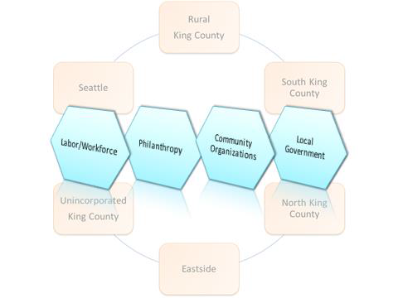
A major conclusion from these interactions with partner organizations is that as a region there is a need for increased coordination and cross-sector activities on solutions that are commensurate with the scale of the challenge of our inequities.

Slide 8
Notes:
And CAP goals

Slide 9
Play #3: Assess success through evaluation
Do we intentionally assess our success in achieving our goals?
Are we able to make judgements about our impact with the information available to us?
Do we take the time to reflect on progress in a structured way?
Do we adjust or change what we are working on based on thoughtful, rigorous assessments?
Source: U.S. Performance Improvement Council
Notes:
Note this says structured way, not punitive way
I would also add a collaborative way focused on problem solving

Slide 10
How can we drive meaningful data-driven reviews in government?
Focus on problems, not jargon
Roll up your sleeves and get your hands dirty
Follow leaders who make data an imperative, and then become one
Place an emphasis on unlocking data internally, not just externally
Don’t tolerate the absence of facts and substance
Source: Carter Hewgley, Johns Hopkins University
Notes:
Use HUDstat example

Slide 11
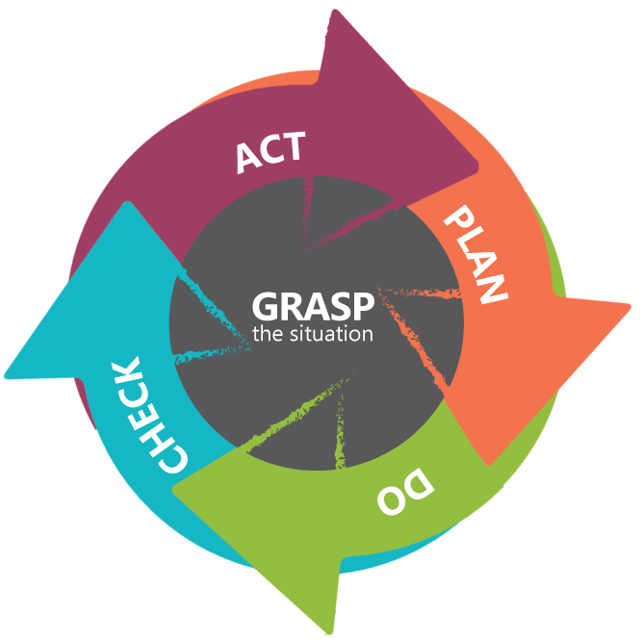

Slide 12
Play #4: Capture valid information through data
Can data be easily located and gathered?
Do we have a way to understand if the information is true or correct?
Do we or other people use our information to make decisions?
Do we ask customers about how we are doing how we can do it better?
Source: U.S. Performance Improvement Council
Notes:
This is where innovation comes in, there’s no reason to make better, faster, cheaper that which should not be made at all
TDK, Lawnmower

Slide 14
Notes:
No reason to make better faster cheaper that which should not be made at all
Focus on customer outcomes, not widgets
Once you define the outcome, then determine if the widget is appropriate
This is exacerbated through competition

Slide 15
Play #5: Generate insights through analysis
Are we able to identify if there are trends that show us how we tend to perform?
Are we able to find specific issues that need to be addressed?
Do we have the skills needed to understand the information we have available to us?
Are there standards or processes we use to make sense of data?
Do we benchmark against our past performance, other comparable groups or across geographic regions to understand how well we are doing in context?
Source: U.S. Performance Improvement Council
Notes:
Focus on trends not targets
I care a lot more about answering the question “why” supported by evidence then whether we made a target
Also takes the onus off the individual or the department, and puts the onus on how we work together to solve a problem
If this isn’t about learning and growth then it’s a complete waste of time

Slide 16
Problem solving for impact in San Francisco, CA

Slide 18
Play #6: Understand what to track through measurement
Do we include people external to our organization or team when determining what to measure?
Are the definitions of success we use reflective of multiple stakeholder perspectives?
Would the majority of us agree that we are tracking the “right” things?
Do we revise our measures over time? Does this make them easier to understand and capture?
Are we using measures that will capture final outcomes rather than just counting stuff?
Source: U.S. Performance Improvement Council

Slide 19
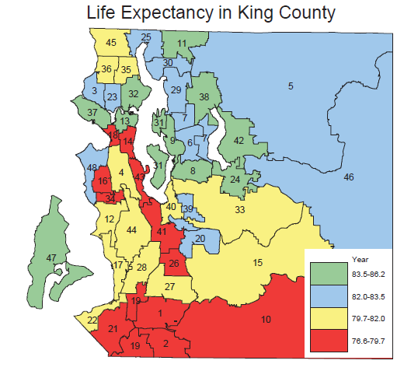
The percent of adults without health insurance has dropped from 16.4% (2014) to 10.1% (2016).
However, approximately 139,000 working age adults remain uninsured in our community.
Overall life expectancy for King County residents ~81.6, but…

Slide 20
Doesn’t look like that much, but watch how it comes to life…https://www.themarshallproject.org/2016/08/18/crime-in-context#.cIebqKrFn Newark and new orleans comparison after katrina and during recession – see boom in homicides – those are more apparent causal factors, but all about asking questions of data Need to compare demographic information to see relative comparison – but even still, the data begs questions
Source: Carter Hewgley, Johns Hopkins University

Slide 21
Comparing Outputs and Outcomes
So what really is the difference between outputs and outcomes?
Outputs | Outcomes
Number of housing units rehabilitated | Increases in equity (property value) of rehabilitated houses for low-income families as a results of targeted assistance
Number of businesses assisted through loans and training | Percent of businesses that remain viable 3 years after assistance
Number of people served by water/sewer projects | Increased percent of people with access to clean drinking water
Number of acres of agricultural lands with conservation plans | Percent improvement in soil quality; dollars saved in flood mitigation
Source: Performance Institute

Slide 22
Play #7: Manage and deliver results
In our daily work, do we discuss or think about how to address performance issues?
Do we manage differently when we see results?
Do we conduct regular data-driven reviews with senior leaders to discuss how we deliver results? Do we talk about what we should change for improved results?
Do we have clear roles and responsibilities for how we accomplish our mission? Are all of us aware and on the same page about them?
Source: U.S. Performance Improvement Council

Slide 24
Power Play #8: Enable and invest in culture
Do we believe this is more than compliance? Do others believe the same?
Do we practice results-oriented candor and transparency?
Do we have a healthy attitude towards risk?
Do we believe in shared accountability?
Are we customer oriented?
Source: U.S. Performance Improvement Council

Slide 25
Discussion: How to keep performance management from being that other thing you do when you have spare time?
Performance management needs to be more than data calls, reporting, accountability and counting things. It’s about problem solving, collaboration and learning and growth. But getting other people who are not “believers” to see the light can be challenging. Yet, in order to build a sense of community, shared accountability, and an outcome-focused government, our teams need to be on the same wavelength.
Today’s collaborative discussion will hopefully allow you to learn some strategies from your peers on how to make performance management relevant, meaningful, and impactful.
First: Identify the top 3 challenges you face when trying to get people to ”buy-in” to performance management and the top 3 strategies you’ve used or would use to overcome those objections?
Second: Share 1 story from your office within the State or local government where you were only able to achieve a breakthrough improvement through collaborative problem solving. Or, share 1 strategy that you think is critical to achieving breakthrough improvements collaboratively.
Notes:
Balanced scorecard – really just a tool to help us track progress in a more comprehensive way

Slide 26
Key Steps in Performance Management
1
Understand your leadership’s top priorities and key challenges
2
Identify key questions – Is the theory of change working and are the systems working?
3
Review and analyze your current suite of performance indicators—fit/gap
4
Develop logic model(s) for top priority activities aligned to the strategic plan
5
Determine what data are needed, current availability, and how to gather it
6
Establish a refined list of meaningful performance indicators and set stretch targets
7
Create a culture of collaborative data-driven management to answer key questions

Slide 27
Appendix

Slide 28
Play #9: Communicate and share performance information
Are our leaders able to see or learn of our progress easily and readily?
Are we able to ask each other for candid feedback about the performance of our program, initiative or organization?
Do we have a way of providing performance updates to our stakeholders?
Do we focus on sharing information internally as much as we do externally?
Source: U.S. Performance Improvement Council

Slide 29
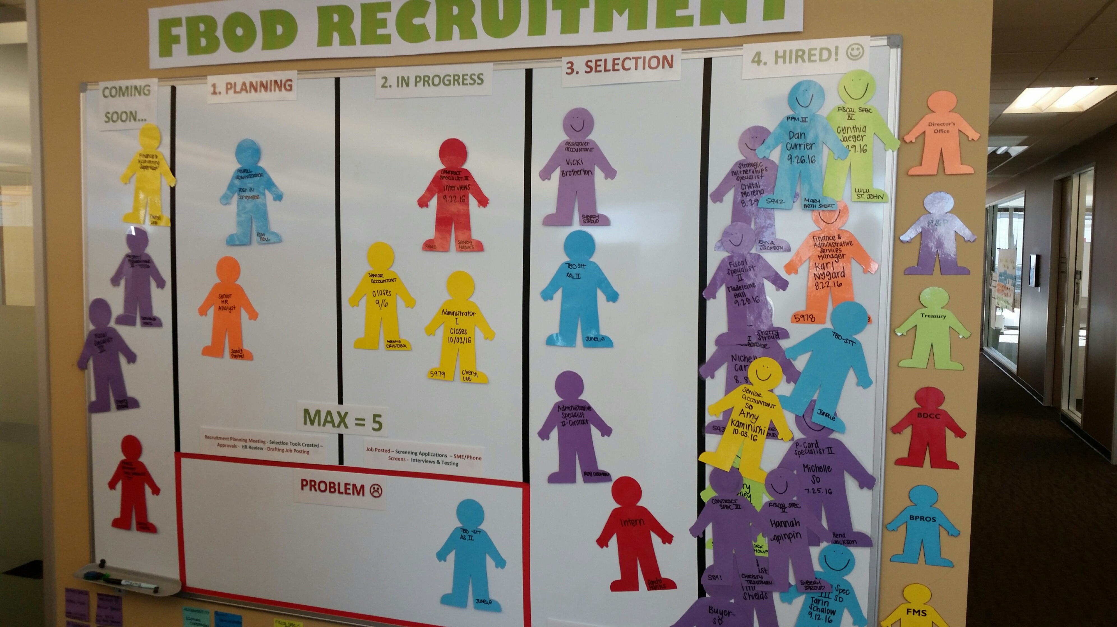

Slide 30
Play #10: Drive needed changes and improvement
Do we have improvement tools or techniques that we can apply when needed?
Are we collaborating with improvement experts in our organization to tackle complex challenges?
Do we actually implement improvements? Do we track their impact?
Are we supported when we need to make necessary changes?
Source: U.S. Performance Improvement Council

Slide 31
What are the key characteristics of a good measure?
Characteristic | Description
Meaningful | Reports tangible and significant accomplishments against objectives; useful for decision makers and other stakeholders
Clear | Easily understood by all; tells a compelling story
Legitimate | Accepted by those who must use it
Consistent | Clear definition and data collection methodology
Reliable | Captures what it intends to measure in an unbiased way
Granular | Able to detect shifts in performance in an actionable way
Relevant | Avoids obsolescence; sets a pattern or baseline of performance
Technically Adequate | Available data is accurate, valid, and timely
Responsible | Does not drive unintended, undesirable consequences or perverse incentives
Actionable | Can be used to drive action and make decisions based off of the results of those actions
Accountable | Promotes ownership and leadership
Feasible | Data is accessible at a cost that makes good business sense
Source: Performance Institute

Slide 32
Building Block | So what?
Leadership & Culture | Management by performance data; breaking down silos; fostering a sense of shared accountability and team building; establishing feedback loops (internal/external); learning measures
Strategy | Strategic goals that align to mission; objectives that align to outcomes; performance goals that align to operations; measures that go beyond compliance and are used to manage
Data & Evidence | Multiple sources; reports, evaluations, models, voice of the customer; illuminates opportunities; put into practice and used for decision making; incorporate evaluation and behavioral science
Capability & Capacity | Focus on capacity building and closing skill gaps; rotate high performers; bring in other rockstars
Collaboration | Break down silos; identify where you can accomplish more collectively than you can individually; develop cross-organizational mission and management goals that drive progress towards shared priorities
Process | Understand what makes sense and what doesn’t – scale and fix; get rid of CYA-focused policies; undo backlogs, bottlenecks, batching; eliminate waste, then eliminate some more; quantify work as tangible things – widgets and/or services
Technology | Only use once previous step is completed; amazing technology on top of bad process produces worse results; use technology as a game changer for any PM approach; use for management and engagement
Innovation | There is no reason to make better, faster, cheaper that which should not be made at all; pressure test what you’re doing; ensure you’re producing the right widgets/services before improving
Interactive Storytelling | Wrap narrative around data to communicate in new, interactive, and compelling ways

